Slide 1

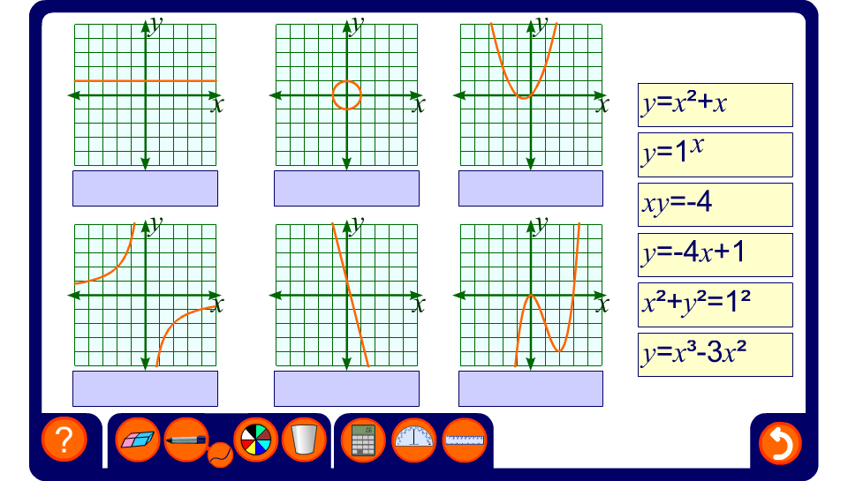


Matching graphs with equations
Notes:
Ask pupils for the names of the functions as they are matched to their corresponding graphs.

